Slide 1

Natural Language Processing DLO 8012
Subject In-charge
Ms Vincy Joseph
Assistant Professor
email: vincyjoseph@sfit.ac.in

Slide 2
Module VI
Lecture 38 Applications of NLP

Slide 3
Text Categorization/ Text Classification

Slide 4
Text Categorization
The goal in automatic text classification is to assign a document to a category by evaluating its text components.
The dataset is split into training and testing dataset for the classification process.
Then starts the actual processing of text data.

Slide 5
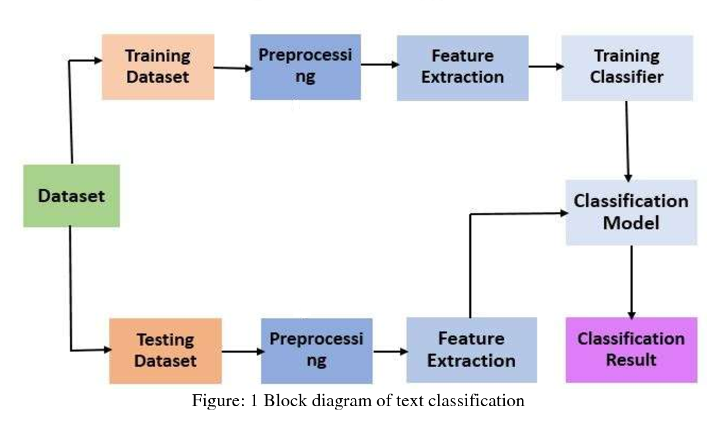
Text Categorization

Slide 6
Text Preprocessing
The main objective of pre-processing is to obtain the key features or key terms from stored text documents
Pre-processing step is crucial in determining the quality of the classification.
It is important to select the significant keywords that carry the meaning and discard the words that do not contribute for classification task.
The pre-processing phase converts the original textual data in a data mining ready structure.

Slide 7
Text Preprocessing
In general, text can be represented in two separate ways.
The first is as a bag-of-words, in which a document is represented as a set of words, together with their associated frequency in the document.
In this process, a text is represented as the container of its words, disregarding grammar and even word order but keeping multiplicity.
The bag-of-words model is commonly used in document classification(here the (frequency of) occurrence of each word is used)
The second method is to represent text directly as strings(a sequence of words)

Slide 8
1. Tokenization
Tokenization is a pre-processing method which breaks a stream of text into words, phrases, symbols, or other meaningful elements called tokens.
Example :
After sleeping for four hours, he decided to sleep for another four.
The tokens are as follows:
{ “After” “sleeping” “for” “four” “hours” “he” “decided” “to” “sleep” “for” “another” “four” }.

Slide 9
2. Stop Word Removal
Removes insignificant words such as {“a”, “about”, “above”, “across”, “after”, “afterwards”, “again”,. . .}.

Slide 10
3. Capitalization
The most common approach for dealing with inconsistent capitalization is to reduce every letter to lower case.
Exception : Problem for the interpretation of some words (e.g., “US” (United States of America) to “us” (pronoun)).
Slang and abbreviation converters can help account for these exceptions.

Slide 11
4. Slang and Abbreviation
A common method for dealing with these words is converting them into formal language.

Slide 12
5. Noise Removal
Removes punctuation and special characters.

Slide 13
6. Spelling Correction
Spelling correction is an optional pre-processing step.
Typos (short for typographical errors) are commonly present in texts and documents, especially in social media text data sets (e.g., Twitter).

Slide 14
7. Stemming
In NLP, one word could appear in different forms (i.e., singular and plural noun form) while the semantic meaning of each form is the same.
For example, the stem of the word “studying” is “study”.

Slide 15
8. Lemmatization
Lemmatization is a NLP process that replaces the suffix of a word with a different one or removes the suffix of a word completely to get the basic word form (lemma).

Slide 16
Feature Extraction
The common techniques of feature extractions are
Term Frequency-Inverse Document Frequency (TF-IDF)
Term Frequency (TF)
Word2Vec
Global Vectors for Word Representation (GloVe).

Slide 17
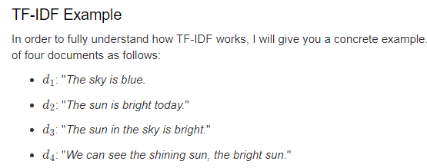
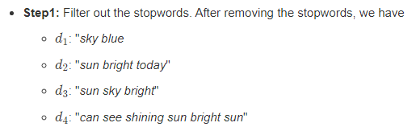

Slide 18
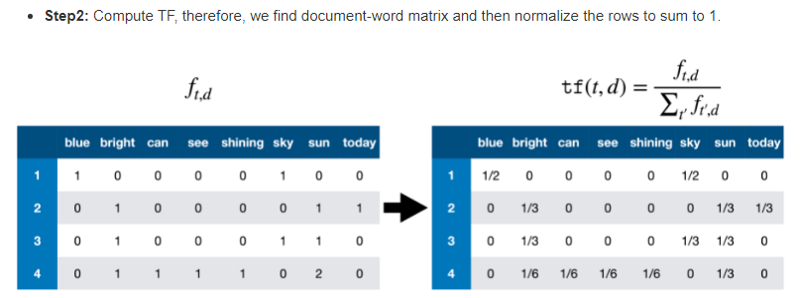

Slide 19
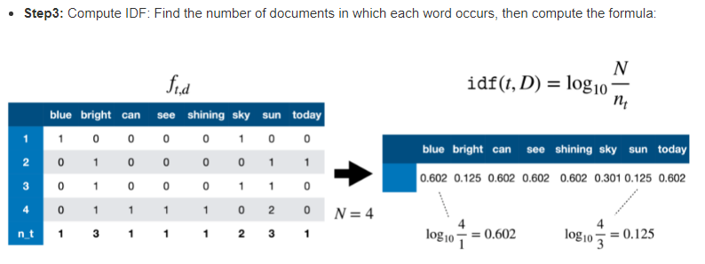

Slide 20
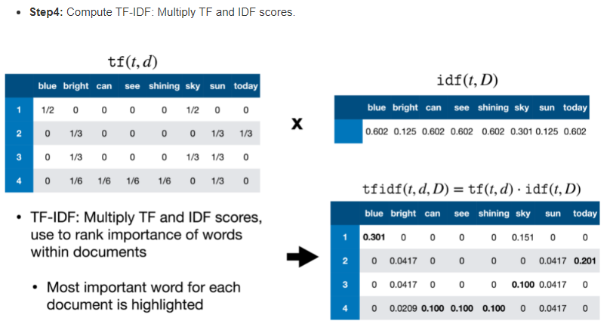

Slide 21
Reference
https://sci2lab.github.io/ml_tutorial/tfidf/

Slide 22
Dimensionality Reduction
Using dimensionality reduction reduce the time and memory complexity for the text classification application.
The most common techniques of dimensionality reduction include
Principal Component Analysis (PCA)
Linear Discriminant Analysis (LDA)
Non-negative Matrix Factorization (NMF).

Slide 23
Naive Bayes Classifier
These are probabilistic
Multinomial models are used by Naïve Bayes for large datasets.
The performance could be enhanced by searching the dependencies among attributes.
Bayesian reasoning and probability inference are employed in predicting the target class.

Slide 24
Support Vector Machine
SVMs are particularly suitable for high dimensional data.
There are so many reasons supporting this claim.
they have better generalization abilities.
SVMs also perform with the same accuracy even when the data is sparse.

Slide 25
K-Nearest Neighbor
K-Nearest Neighbor (k-NN) works on the principle of closest training samples, those data points that are close to each other belong to one particular class, commonly called instance-based learning.
Though it is robust for noisy data, deciding the value of k is complicated.
Computational complexity further increases with increase in dimensionality.

Slide 26
Artificial Neural Networks
Artificial neural networks (ANNs) work in the same way as the human brain in arriving at a decision.
It works on the virtue of learning and evolution with minimal or no human intervention.
For data classification, competitive co-evolution algorithm based neural network model is suggested.
Radial Basis Function is the ANN component as it employs faster learning algorithms.
It has a compact network architecture that increases classification accuracy.

Slide 27
Centroid-based Classifier
The centroid-based classification algorithm is very simple.
For each set of documents belonging to the same class, we compute their centroid vectors.
If there are k classes in the training set, this leads to k centroid vectors (C1, C2, C3...) where each Cn is the centroid for the jet class.
The class of a new document x is determined as follows. First the document-frequencies of the various terms computed from the training set.
Then, compute the similarity between x to all k centroid using the cosine measure.
Finally, based on these similarities, and assign x to the class corresponding to the most similar centroid

Slide 28
Clustering
The clustering is the task of finding groups of similar documents in a collection of documents.
The similarity is computed by using a similarity function.

Slide 29
k-means Clustering
The k-means clustering, partitions n documents in the context of text data into k clusters.

Slide 30
Ontology Based Classification
Traditional classification methods ignore relationships between words.
But there exists a semantic relation between terms such as synonymy,hyponymy etc.
Thus for better classification results these semantic relations need to be considered.
Ontology stores words related to a particular domain and this can be used for classification. E.g. Lingo algorithm.

Slide 31
Lingo Algorithm
The general idea behind LINGO is to first find meaningful descriptions of clusters, and then, based on the descriptions, determine their content.
To assign documents to the already labeled groups LINGO could use the Latent Semantic Indexing (LSI) in the setting for which it was originally designed: given a query – retrieve the best matching documents.
When a cluster label is fed into the LSI as a query, as a result contents of the cluster will be returned.

Slide 32
Lingo Algorithm
This approach should take advantage of the LSI's ability to capture high-order semantic dependencies in the input collection.
In this way not only would documents that contain the cluster label be retrieved, but also the documents in which the same concept is expressed without using the exact phrase.

Slide 33
Text Summarization

Slide 34
Text Summarization
Text summarization refers to the technique of shortening long pieces of text.
The intention is to create a coherent and fluent summary having only the main points outlined in the document.
There are two main types of how to summarize text in NLP:
Extraction-based summarization
Abstraction-based summarization

Slide 35
Extraction-based Summarization
The extractive text summarization technique involves pulling keyphrases from the source document and combining them to make a summary.
The extraction is made according to the defined metric without making any changes to the texts.
Here is an example:
Source text: Joseph and Mary rode on a donkey to attend the annual event in Jerusalem. In the city, Mary gave birth to a child named Jesus.
Extractive summary: Joseph and Mary attend event Jerusalem. Mary birth Jesus.
As you can see above, the important words have been extracted and joined to create a summary — although sometimes the summary can be grammatically strange.

Slide 36
Abstraction-based Summarization
The abstraction technique entails paraphrasing and shortening parts of the source document.
It can overcome grammar inconsistencies of extractive method.
These algorithms create new phrases and sentences just like humans do.
The abstraction based text summarization algorithms are more difficult to develop.
Example:
Abstractive summary: Joseph and Mary came to Jerusalem where Jesus was born.

Slide 37
How does a text summarization algorithm work?
Usually, text summarization in NLP is treated as a supervised machine learning problem (where future outcomes are predicted based on provided data). Typically, here is how using the extraction-based approach to summarize texts can work:
1. Introduce a method to extract the merited keyphrases from the source document. For example, you can use part-of-speech tagging, words sequences, or other linguistic patterns to identify the keyphrases.
2. Gather text documents with positively-labeled keyphrases. The keyphrases should be compatible to the stipulated extraction technique. To increase accuracy, you can also create negatively-labeled keyphrases.
3. Train a binary machine learning classifier to make the text summarization.

Slide 38
How does a text summarization algorithm work?
Some of the features you can use include:
● Length of the keyphrase
● Frequency of the keyphrase
● The most recurring word in the keyphrase
● Number of characters in the keyphrase
4. Finally, in the test phrase, create all the keyphrase words and sentences and carry out classification for them.

Slide 39
A general Text Summarization system

Slide 40
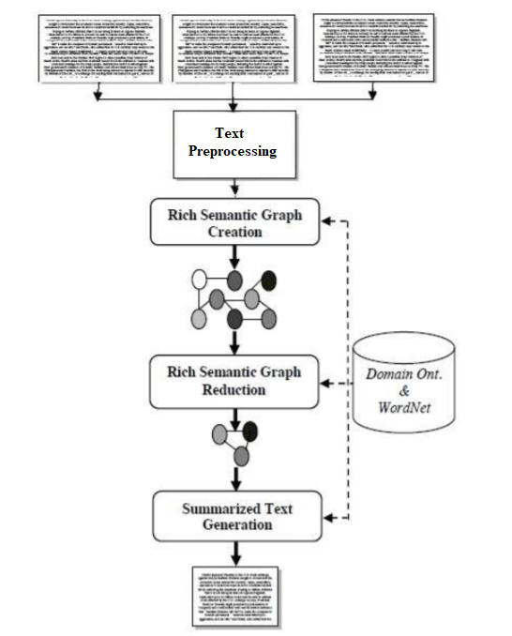

Slide 41
A general text summarization system
The system uses the multiple documents in order to create abstractive summarization.
At first, a semantic graph is generated for every sentence in the documents by preprocessing each sentence.
Thereafter, the generated graph is reduced to a more reduced graph to generate abstractive summary.
Heuristic rules have been used to generate an abstractive summary.
The goal of the system is to condense the documents into a shorter version and preserve important contents.

Slide 42
Text Preprocessing Module
Preprocessing module is responsible to accept the input text, and converts it to preprocessed sentences.
It consists of four main processes: named entity recognition, morphological and syntactic analysis, cross-reference resolution, and pronominal resolution processes.

Slide 43
Text Preprocessing Module
The named entity recognition process locates atomic elements into predefined categories such as person names, organizations, etc.
In morphological analysis, each word is divided into morphemes and figures out its grammatical categories, the syntactic analysis parses the whole sentence to describe each word syntactic function and build the parse tree, and typed dependencies expresses syntactic knowledge in terms of direct relationships between words.
Co-reference and pronominal resolution reference resolution processes identify co-reference named entities and resolve pronominal references in the whole input text.
Co-reference is defined as the identification of surface terms (words within the document) that refer to the same entity.

Slide 44
Rich Semantic Sub-graphs Generation Module
The main objective of the Rich Semantic Graph Creation Phase is to represent the input documents semantically using Rich Semantic Graph (RSG).
Unlike traditional semantic graph, the Rich Semantic Graph is able to capture the meaning of words, sentences, and paragraphs.
The Rich Semantic Sub-graphs Generation module is responsible to transform each preprocessed sentence to a set of ranked rich semantic subgraphs.

Slide 45
Rich Semantic Sub-graphs Generation Module
The main objective of the Rich Semantic Sub-graphs Generation module is to generate multiple rich semantic sub-graphs for each input preprocessed sentence.
This module includes three processes: Word Senses Instantiation, Concepts Validation, and Semantic Sentences Ranking processes.

Slide 46
Rich Semantic Sub-graphs Generation Module
Word Senses Instantiation process: For each input preprocessed sentence, this process instantiates a set of word concepts for both noun and verb senses based on the domain ontology.
Concept Validation Process: In this process, for each preprocessed sentence, the sentence concepts instantiated are interconnected and validated to generate multiple rich semantic sub-graphs.

Slide 47
Rich Semantic Sub-graphs Generation Module
Sentences Ranking Process: It aims to rank and to threshold the highest ranked rich semantic sub-graphs for each sentence. To generate single rich semantic graph and to keep the semantic consistency for the whole sentence, the process considers the first ranked rich semantic sub-graph only. The ranking method is based on deriving the average weight of each concept (word sense). The weight of the word concept is derived according to its usage popularity (Wordnet usage popularity).

Slide 48
The Rich Semantic Graph Generation module
Finally, the Rich Semantic Graph Generation module is responsible to generate the final rich semantic graphs of the whole input document from the highest-ranked rich semantic sub-graphs of the document sentences.
The semantic sub-graphs of the input document will be merged to form the final rich semantic graph.

Slide 49
The Rich Semantic Graph Reduction Phase
This phase aims to reduce the generated rich semantic graph of the original document to a more reduced graph.
In this phase, a set of heuristic rules are applied on the generated rich semantic graph to reduce it by merging, deleting, or consolidating the graph nodes.

Slide 50
The Rich Semantic Graph Reduction Phase
Example of a rule
Sentence1= [SN1, MV1, ON1]
Sentence2= [SN2, MV2, ON2]
Each sentence is composed of three nodes: Subject Noun (SN) node, Main verb (MV) node and Object Noun (ON) node.

Slide 51
Rule 1.
IF SN1 is instance of noun N And
SN2 is instance of noun N And
MV1 is similar to MV2 And
ON1 is similar to ON2
THEN
Merge both MV1 and MV2 And
Merge both ON1 and ON2

Slide 52
The Text Generation Phase
The Rich Semantic Graph Generation module is responsible for generating a set of ranked RSGs for the input ranked semantic sub-graphs.
This phase aims to generate the abstractive summary from the reduced Rich Semantic Graph (RSG).
There are four modules namely the Text planning, the Sentence Planning, the Surface Realization, and the Evaluation modules.
These modules are performed by processes arranged as a pipeline, so the output of each process is the input of the next one as shown in figure 4.

Slide 53
The Text Generation Phase
1) The Text Planning module: It aims to select the appropriate content material to be expressed in the final text. This phase includes one process called “Content Determination”, which decides what information should be included in the generated text.
2) The Sentence Planning module: It specifies the sentence boundaries, and generates and orders intermediate paragraphs. The main objective of this phase is to improve the fluency or understandability of the text.

Slide 54
The Text Generation Phase
The sentence planning consists of four main processes:
1. Lexicalization Process: In this process, for each verb/noun object, its synonyms are selected by accessing the WordNet ontology to generate the target content.
2. Discourse Structuring Process: The main aim of this process is to build a structure that contains the selected object synonyms in the form of pseudo-sentences.
3. Aggregation Process: The main aim of this process is to decide how pseudo-sentences should be combined into semi-paragraphs.
4. Referring Expression Process: This process identifies and replaces the intended referent by its appropriate pronoun.

Slide 55
The Text Generation Phase
3) The Surface Realization module: This phase aims to transform the enhanced semi-paragraphs into paragraphs by correcting them grammatically (inflect words for tense, etc.) and adding the required punctuation (capitalization adding semicolon, etc).
4) The Evaluation module: The main objective of this phase is to evaluate and then rank the paragraphs according to two factors: coherence between paragraph sentences and the most frequently used paragraph word synonyms.

Slide 56
Sentiment Analysis

Slide 57
Sentiment Analysis
Sentiment classification is a task under Sentiment Analysis (SA) that deals with automatically tagging text as positive, negative or neutral from the perspective of the speaker/writer with respect to a topic.
Thus, a sentiment classifier tags the sentence ‘The movie is entertaining and totally worth your money!’ in a movie review as positive with respect to the movie.
On the other hand, a sentence ‘The movie is so boring that I was dozing away through the second half.’ is labeled as negative.
Finally, ‘The movie is directed by Nolan’ is labeled as neutral.

Slide 58
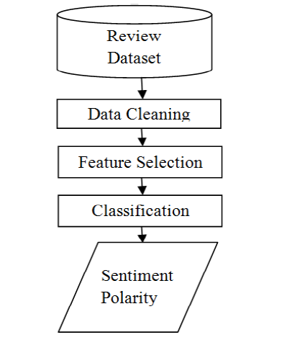
The general block diagram for a sentiment analysis system is as given below:

Slide 59
Data collection
Data is collected from various social networking sites, blogging sites, and review sites

Slide 60
Data Cleaning
1. Removal of URL’s: Data extracted may contain some url’s which needs to be removed as they do not contain any sentiments.
2. Case conversion: All the text should be converted to either upper case or lower case i.e. there should be no difference between ‘paper’ and ‘PAPER’.
3. Removal of punctuation: Punctuation such as full stop, exclamatory sign, comma’s etc should be removed as they do not represent any emotions.
4. Removal of Hash tag: Hash tag word is preceded by a hash sign(#) and is generally used in social media for the identification of specific subjects.

Slide 61
Data Cleaning
5. Tokenization : It divides given text into tokens.
6. Stemming: M.F. porter stemmer is most widely used algorithm which stems the word.
7. Negation rule: This method removes negation word which reverses meaning of word in review.
8. Conjunction rule: This method extracts meaning from review using grammatical rule.

Slide 62
Feature Extraction and Selection

Slide 63
Feature Extraction
Some of feature extraction techniques are
1. Terms presence and frequency: It is based on individual word or n-grams and frequency counts.
2. Parts of Speech (POS): It extracts adjective nouns from data.
3. Opinion words and phrase: It is based on words which represents opinions such as good or bad, like or hate etc.
4. Negation: Appearance of negation words in text may reverse the meaning of opinion. For example “not good” is equal to “bad”.

Slide 64
Feature Selection
Feature Selection methods can be divided into lexicon-based methods that need human annotation, and statistical methods which are automatic methods that are more frequently used. Lexicon-based approaches usually begin with a small set of ‘seed’ words. Then they bootstrap this set through synonym detection or on-line resources to obtain a larger lexicon. Statistical approaches, on the other hand, are fully automatic.
The feature selection techniques treat the documents either as group of words (Bag of Words (BOWs)), or as a string which retains the sequence of words in the document. BOW is used more often because of its simplicity for the classification process.

Slide 65
Feature Selection
Various feature selection methods are CountVectorizer ,TF-IDF(Term Frequency–Inverse Document Frequency), IG(Information Gain), MI(Mutual Information), Feature Vector, Unigram, Bigram and N-gram methods.TF-IDF score is to be taken into consideration to balance most weighted and less weighted word. Chi square method gives good results for both positive and negative classes. Mutual information, Chi-square, TF-IDF and Information Gain techniques are used to select feature from high dimensional data

Slide 66
Feature Selection
1. Count Vector : It is defined by the number of occurrences of features in review.
2. TF-IDF : It is defined by multiplying the value of frequency of word in review (TF) and frequency of word in whole corpus (IDF).
TF-IDFi = ti,j * log (N/dfi)
TF-IDFi is the weight of a term i. ti,j is the frequency of term i in sample j. N is the total number of samples in the corpus. dfi is the number of samples containing term i.
3. Information gain is the most widely used attribute selection measure in the area of sentiment analysis. It determines the relevant features to predict review by studying the presence or absence of features in a document.
P(c|f) is the joint probability, class is c and feature is f and P(c) denotes the marginal probability.

Slide 67
Feature Selection
4. Mutual Information: MI is the process of selecting features that are not uniformly distributed across the sentiment classes because they are informative of their classes and we can see that MI gives more importance to only a few terms.
Where P(f,c) represents joint probability distribution function, P(f) and p(c) represent marginal probability distribution of f and c. c is positive and negative classes.
5. Chi-square: Chi-square measures observed count and expected count and analyzed how much deviation occurs between them.
W, X, Y, Z represents the frequencies, represent the presence or absence of feature in the sample. W is the count of samples in which feature f and c occurred together. N=W+X+Y+Z. f represents the feature and c represents the class.

Slide 68
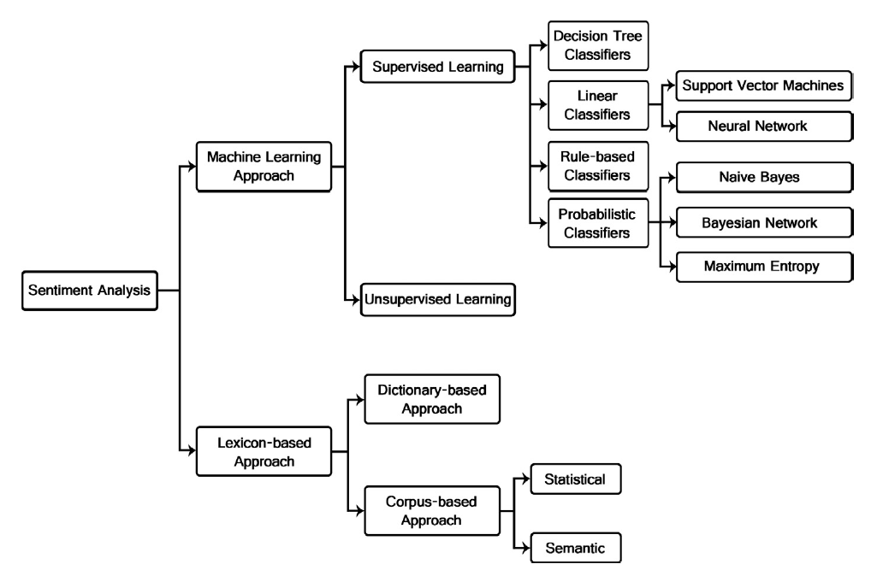
Classification

Slide 69
Classification
Sentiment Classification techniques can be roughly divided into machine learning approach, lexicon based approach and hybrid approach. The Machine Learning Approach (ML) applies the famous ML algorithms and uses linguistic features. The Lexicon-based Approach relies on a sentiment lexicon, a collection of known and precompiled sentiment erms. It is divided into dictionary-based approaches and corpus-based approaches which use statistical or semantic methods to find sentiment polarity. The hybrid Approach combines both approaches and is very common with sentiment lexicons playing a key role in the majority of methods.

Slide 70
Classification
The classification methods using ML approach can be roughly divided into supervised and unsupervised learning methods. The supervised methods make use of a large number of labeled training documents. The unsupervised methods are used when it is difficult to find these labeled training documents.

Slide 71
Classification
The lexicon-based approach depends on finding the opinion lexicon which is used to analyze the text. There are two methods in this approach. The dictionary-based approach which depends on finding opinion seed words, and then searches the dictionary of their synonyms and antonyms. The corpus-based approach begins with a seed list of opinion words, and then finds other opinion words in a large corpus to help in finding opinion words with context specific orientations. This could be done by using statistical or semantic methods.

Slide 72
Supervised Learning
The supervised learning methods depend on the existence of labeled training documents. There are many kinds of supervised classifiers.
1. Probabilistic classifiers. Probabilistic classifiers use mixture models for classification. The mixture model assumes that each class is a component of the mixture. Each mixture component is a generative model that provides the probability of sampling a particular term for that component. These kinds of classifiers are also called generative classifiers. Three of the most famous probabilistic classifiers are

Slide 73
Supervised Learning
a. Naıve Bayes Classifier (NB). The Naıve Bayes classifier is the simplest and most commonly used classifier. Naıve Bayes classification model computes the posterior probability of a class, based on the distribution of the words in the document. The model works with the BOWs feature extraction which ignores the position of the word in the document. It uses Bayes Theorem to predict the probability that a given feature set belongs to a particular label.

Slide 74
Supervised Learning
b. Bayesian Network (BN). The main assumption of the NB classifier is the independence of the features. The other extreme assumption is to assume that all the features are fully dependent. This leads to the Bayesian Network model which is a directed acyclic graph whose nodes represent random variables, and edges represent conditional dependencies. BN is considered a complete model for the variables and their relationships. Therefore, a complete joint probability distribution (JPD) over all the variables, is specified for a model. In Text mining, the computation complexity of BN is very expensive; that is why, it is not frequently used

Slide 75

Supervised Learning
c. Maximum Entropy Classifier (ME). The Max ent Classifier (known as a conditional exponential classifier) converts labeled feature sets to vectors using encoding. This encoded vector is then used to calculate weights for each feature that can then be combined to determine the most likely label for a feature set. This classifier is parameterized by a set of X{weights}, which is used to combine the joint features that are generated from a feature-set by an X{encoding}. In particular, the encoding maps each C{(featureset, label)} pair to a vector. The probability of each label is then computed using the following equation:

Slide 76
Supervised Learning
2. Linear classifiers : A linear classifier uses a classification algorithm that makes its classification based on a linear predictor function combining a set of weights with the feature vector.

Slide 77
a. Support Vector Machine
The main principle of SVMs is to determine linear separators in the search space which can best separate the different classes. Text data are ideally suited for SVM classification because of the sparse nature of text, in which few features are irrelevant, but they tend to be correlated with one another and generally organized into linearly separable categories.

Slide 78
b. Neural Network
Neural Network consists of many neurons where the neuron is its basic unit. The inputs to the neurons are denoted by the vector Xi which is the word frequencies in the ith document. There are a set of weights A which are associated with each neuron used in order to compute a function of its inputs f(). The linear function of the neural network is: pi = A. Xi. In a binary classification problem, it is assumed that the class label of Xi is denoted by yi and the sign of the predicted function pi yields the class label.

Slide 79
c. Decision tree classifiers.
Decision tree classifier provides a hierarchical decomposition of the training data space in which a condition on the attribute value is used to divide the data. The condition or predicate is the presence or absence of one or more words. The division of the data space is done recursively until the leaf nodes contain certain minimum numbers of records which are used for the purpose of classification.

Slide 80
d. Rule-based classifiers
In rule based classifiers, the data space is modeled with a set of rules. The left hand side represents a condition on the feature set expressed in disjunctive normal form while the right hand side is the class label. The conditions are on the term presence. Term absence is rarely used because it is not informative in sparse data.

Slide 81
Unsupervised Learning
The main purpose of text classification is to classify documents into a certain number of predefined categories. In order to accomplish that, large number of labeled training documents are used for supervised learning, as illustrated before. In text classification, it is sometimes difficult to create these labeled training documents, but it is easy to collect the unlabeled documents. The unsupervised learning methods overcome these difficulties. Many research works were presented in this field . One of the method divides the documents into sentences, and categorized each sentence using keyword lists of each category and sentence similarity measure.

Slide 82
Lexicon-based approach
Opinion words are employed in many sentiment classification tasks. Positive opinion words are used to express some desired states, while negative opinion words are used to express some undesired states. There are also opinion phrases and idioms which together are called opinion lexicon. There are three main approaches in order to compile or collect the opinion word list. Manual approach is very time consuming and it is not used alone. It is usually combined with the other two automated approaches as a final check to avoid the mistakes that resulted from automated methods. The two automated approaches are presented in the following subsections.

Slide 83
Dictionary-based approach
A small set of opinion words is collected manually with known orientations. Then, this set is grown by searching in the well known corpora WordNet or thesaurus for their synonyms and antonyms. The newly found words are added to the seed list then the next iteration starts. The iterative process stops when no new words are found. After the process is completed, manual inspection can be carried out to remove or correct errors. The dictionary based approach has a major disadvantage which is the inability to find opinion words with domain and context specific orientations

Slide 84
Corpus-based approach
The Corpus-based approach helps to solve the problem of finding opinion words with context specific orientations. Its methods depend on syntactic patterns or patterns that occur together along with a seed list of opinion words to find other opinion words in a large corpus. One of these methods started with a list of seed opinion adjectives, and used them along with a set of linguistic constraints to identify additional adjective opinion words and their orientations.

Slide 85
Corpus-based approach
The constraints are for connectives like AND, OR, BUT, EITHER-OR; the conjunction AND for example says that conjoined adjectives usually have the same orientation. This idea is called sentiment consistency, which is not always consistent practically. There are also adversative expressions such as but, however which are indicated as opinion changes. In order to determine if two conjoined adjectives are of the same or different orientations, learning is applied to a large corpus. Then, the links between adjectives form a graph and clustering is performed on the graph to produce two sets of words: positive and negative.

Slide 86
Named Entity Recognition

Slide 87
Named Entity Recognition
Entities are the who (and some of the what) of text analytics. On the most basic level, an entity in text is simply a proper noun such as a person, place, or product: John Coltrane, Coca Cola, and Indiana are all entities.
Named Entity Recognition is a process where all the named entities which are the proper nouns are identified and classified into their predefined appropriate class. Named-entity recognition (NER) is a subtask of information extraction that seeks to locate and classify named entities in text into predefined categories such as the names of persons, organizations, locations, expressions of times, quantities, monetary values, percentages, etc. Thus it is the task of finding names such as organizations, persons, locations, etc. in text.

Slide 88
Named Entity Recognition
Since whether or not a word is name and the entity type of a name are determined mostly by the context of the word as well as by the entity type of its neighbors, NER is often posed as a sequence classification problem and solved by methods such as hidden Markov models (HMM) and conditional random fields (CRF). In NER the aim is to distinguish between character sequence that represent noun phrases and character sequence that represents normal text.
Named entities are classified into different categories as shown in Figure below:

Slide 89
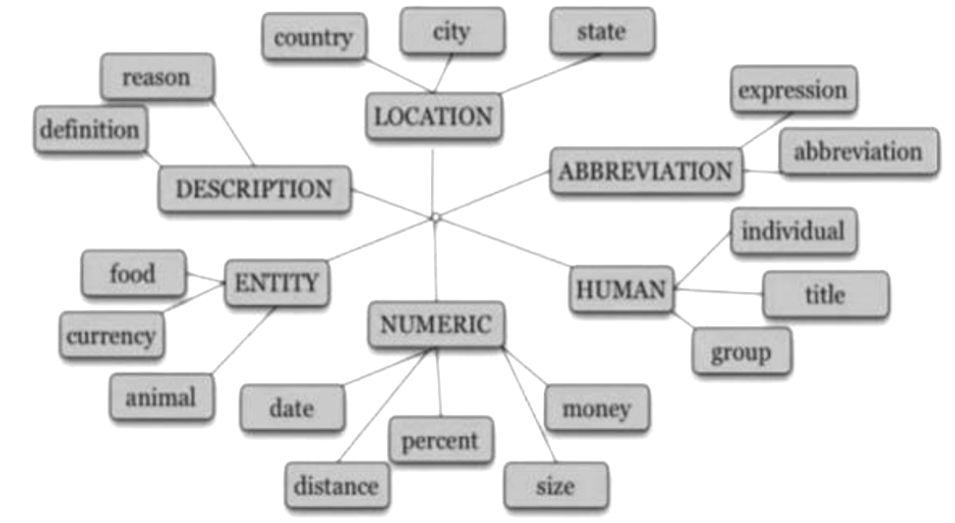
Named Entity Recognition

Slide 90
Named Entity Recognition
The example given below shows the named entities and their classes.
Ram [PER] joined Symbiosis [ORG] in Pune [LOC] on 12th [DATE] Jan [MONTH] 2012 [YEAR] for a 3 [NUMB] course.
NER is subdivided into two stage problems first is identification of proper nouns and classification of these proper nouns into their respective classes. The process of NER involves a few stages where it consists of pre-processing of text, data training, data testing, and lastly result evaluation. These steps are again broadly classified into pre-processing steps, feature extraction, NER algorithms and labeling.

Slide 91
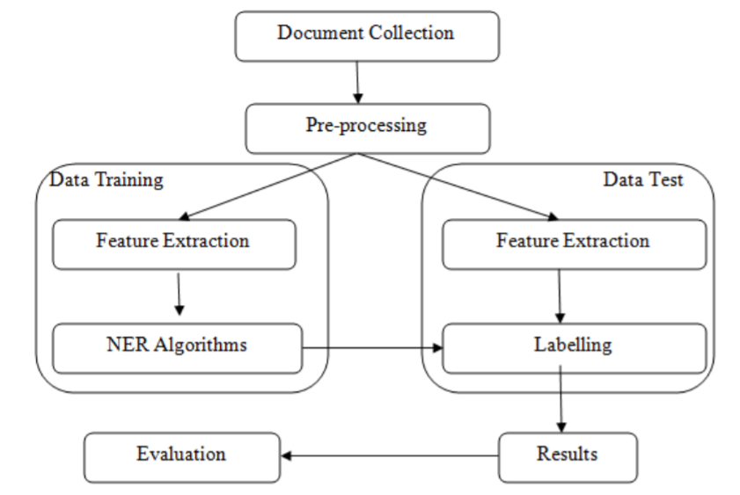
Named Entity Recognition

Slide 92
Named Entity Recognition
Step 1: Document collection
Documents of varied formats such as .pdf, .html, .docx etc. from all sources will be collected. These documents will be inputs for the system.
Step 2: Pre-processing
Data pre-processing describes any type of processing performed on raw data to prepare it for another processing procedure.
Step 2.1: Validation of input document
Validation is to check whether the given input text is in language for which the system is implemented. It also checks whether the input is syntactically correct, but does not check the semantic correctness.

Slide 93
Named Entity Recognition
Step 2.2: Tokenization
The aim of the tokenization is the exploration of the words in a Sentence where every word, symbol, special character in the sentence is considered as a token.
Step 2.3: Stop word removal
In stop word removal, words that occur very frequently and does not contribute much to the context and content, and also have no impact on their existence are removed.
Step 2.4: Stemming
Trimming or cutting out the extraneous words to the stem is called stemming. Here inflections are removed using stemming algorithms. Step 2.5: Morphological analysis
Morphological analysis is the procedure to find out the root word. It is applied to recognize the inner structure of the word.

Slide 94
Named Entity Recognition
Step 3: Data Training:
This step is required to train the system. Training is done based on the feature extraction and the algorithm used. The output of this stage will be given to the testing stage.
Step 3.1: Feature extraction – In this process a small subset from the sentence is extracted and then a feature set is applied to the NER algorithms.
Step 3.2: NER algorithms – Various NER NLP algorithms include rule based, machine learning and hybrid approaches.

Slide 95
Named Entity Recognition
Step 4: Data Testing
Step 4.1: Feature extraction – This process is the same as explained in the training data stage with the test data. The extracted features are then tagged.
Step 4.2: Labeling (tagging) – In this process the entities are tagged using any of the algorithm.
Step 5: Result – the output of all the above stages will be then go through the evaluation stage using evaluation parameters.
Step 6: Evaluation – The accuracy level of NER can done by Precision (P), Recall (R) and F1-measure metrics.

Slide 96
Named Entity Recognition
This process involves two main sub tasks firstly, identifying the proper nouns from the sequence of the text, secondly classifying these proper nouns into their predefined categories. NER task is done by the following rule based approaches. It is also called hand crafted rules or linguistic approach. In this approach the rules are written manually by the researchers for the system and for any particular language. Rule based systems parse the source text and produce an intermediate representation which may be a parse tree or some abstract representation. Rule based are further classified into list lookup approach and linguistic approach

Slide 97
Named Entity Recognition
List lookup Approach : In List Lookup a large corpus which is called as a bag of words are built for all the named entities and their classes. List lookup is performed to identify named entities. This list is also called as gazetteer.
Linguistic Approach: In linguistic approach one should have a deep knowledge of the grammar of any specific language. The understanding and the knowledge of the language leads to more accurate rules so that the named entities will be identified and classified very easily.

Slide 98
Machine Learning Approach
In Machine Learning-based NER systems, the purpose of Named Entity Recognition approach is converting identification problem into a classification problem and employing a classification statistical model to solve it. Machine learning approaches are also named as corpus based approaches. In this type of approach, the systems look for patterns and relationships into text to make a model using statistical models and machine learning algorithms. The systems identify and classify nouns into particular classes such as persons, locations, times, etc based on this model, using machine learning algorithms. There are three types of machine learning models that are used for NER that are Supervised, semi-supervised and unsupervised machine learning model. Supervised learning utilizes only the labelled data to generate a model. Semi-supervised learning aims to combine both the labelled data as well as useful evidence from the unlabelled data in learning. Unsupervised learning is designed to be able to learn without or with very few labelled data. These models will be broadly classified further.

Slide 99
Supervised Machine Learning Approach
Supervised machine approach is also called statistical models. It has proved to be very effective.NER in statistical models usually treat recognising named entities as a sequence tagging problem in which each word is tagged to it entity if its present in the entity class. The process of learning is called supervised, human intervention is needed to train the system by giving the trained data examples to construct the statistical model, which cannot achieve good performance without large amount of training data. Different supervised machine approaches are as follows.

Slide 100
Hidden Markov Model (HMM)
It is a statistical language model that computes the likelihood of a sequence of words by employing a Markov chain, in which the likelihood of the next word is based on the current word. In this language model words are represented by states, NE classes are represented by regions and there is a probability associated with every transition from the current word to the next word. This model can predict the NE class for a next word if the current word and its NE class pair is given. It has a better capability of capturing the locality of phenomena, which indicates names in text.

Slide 101
Maximum Entropy Markov Model (MEMM)
MEMM is also a statistical model which is very flexible. The assignment is output for each word or token is based on its future (f), history (h) and the features (g). Here an essential prerequisite is the selection of appropriate features. A maximum entropy solution to this, or any other similar problem allows the computation of p (f | h) for any f from the space of possible futures, F, for every h from the space of possible histories, H. As the outputs of the models are defined by the futures, the solution for this is to compute p (f | h) for any f from the space of possible futures, F and for any h from the possible histories, H. Thus in NER, finding the probability of f for any token with respect to its index (t) can be formulated as p (f | ht).

Slide 102
Conditional Random Fields
Conditional random fields (CRFs) are a class of statistical modelling method often applied in pattern recognition and machine learning, where they are used for structured prediction. Where, the prediction of labels or tags for entities in any ordinary classifier is done without considering the
context of neighbouring entity, CRF takes the context into account e.g. the linear chain CRF predicts sequences of labels for sequences of input samples. It is a discriminative undirected probabilistic graphical model (random fields) used to encode known relationships between observations and construct consistent interpretations.

Slide 103
End of Module 6

